Slide 1
A Sentence Speaks a Thousand Images: Domain Generalization through Distilling CLIP with Language Guidance

Slide 2
Approach
Method used a CLIP teacher model, to train a smaller model that generalizes to unseen domains.
Technique - Regularization that requires the student’s learned image representations to be close to the teacher’s learned text representations obtained from encoding the corresponding text descriptions of images.
Consider absolute and relative distance loss function for the regularization of student network during training process.

Slide 3
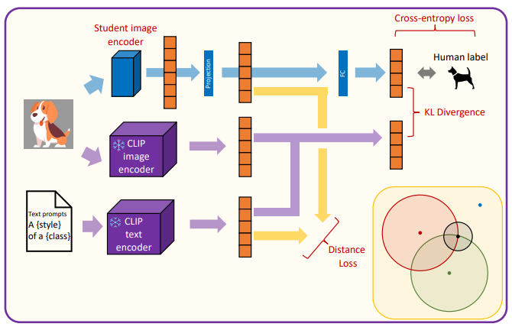
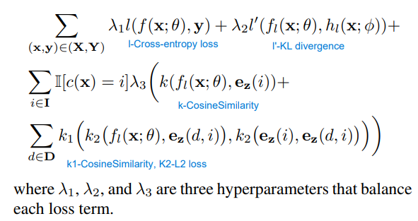
Architecture
Teacher network - CLIP ViT-B/16
Student Network – ResNet50
Full method loss functions
A relative distance loss that can better describe where the target generic representation.
Absolute distance loss is designed to directly push the student’s learned image representation to be close to the teacher’s generic text representation.

Slide 4
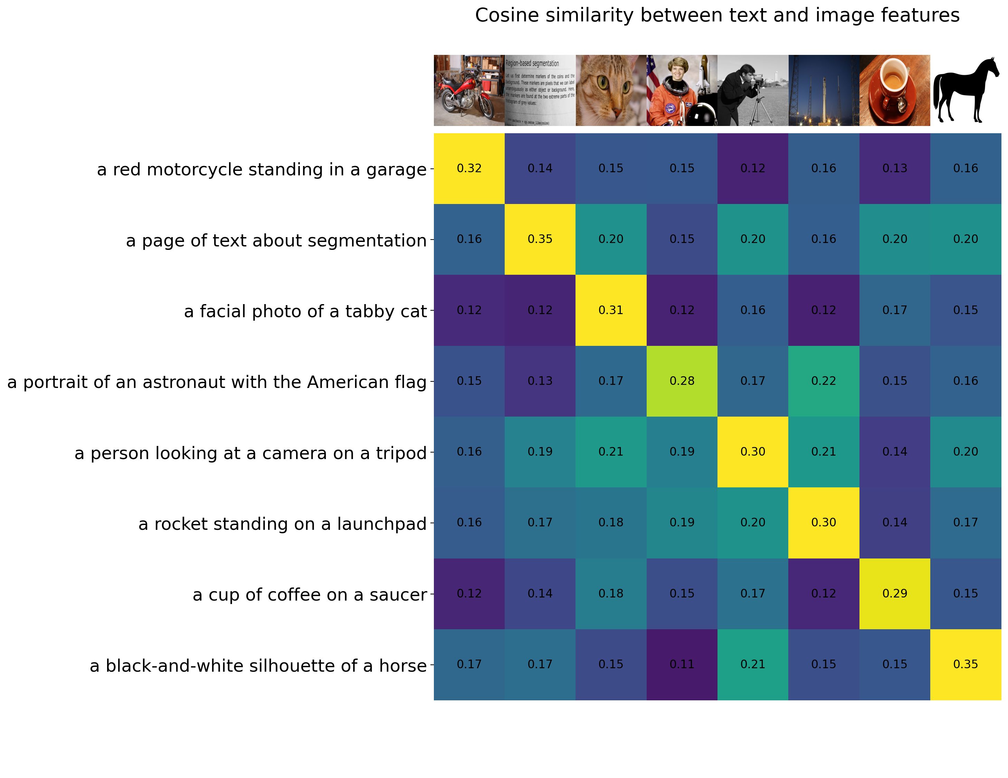
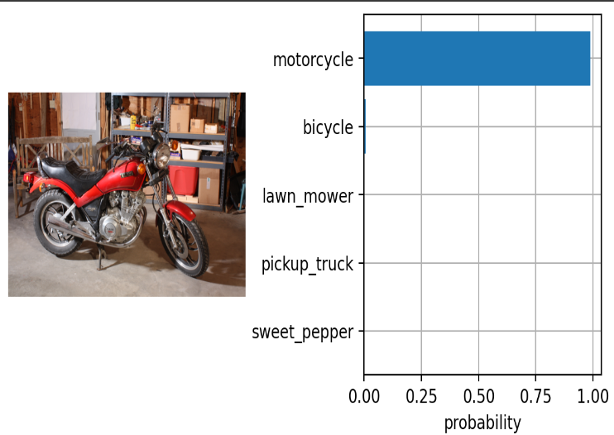
CLIP
Calculate cosine similarity between image and text pairs.
Zero shot image classification
Classify images using the cosine similarity (times 100) as the logits to the SoftMax operation.

Slide 5
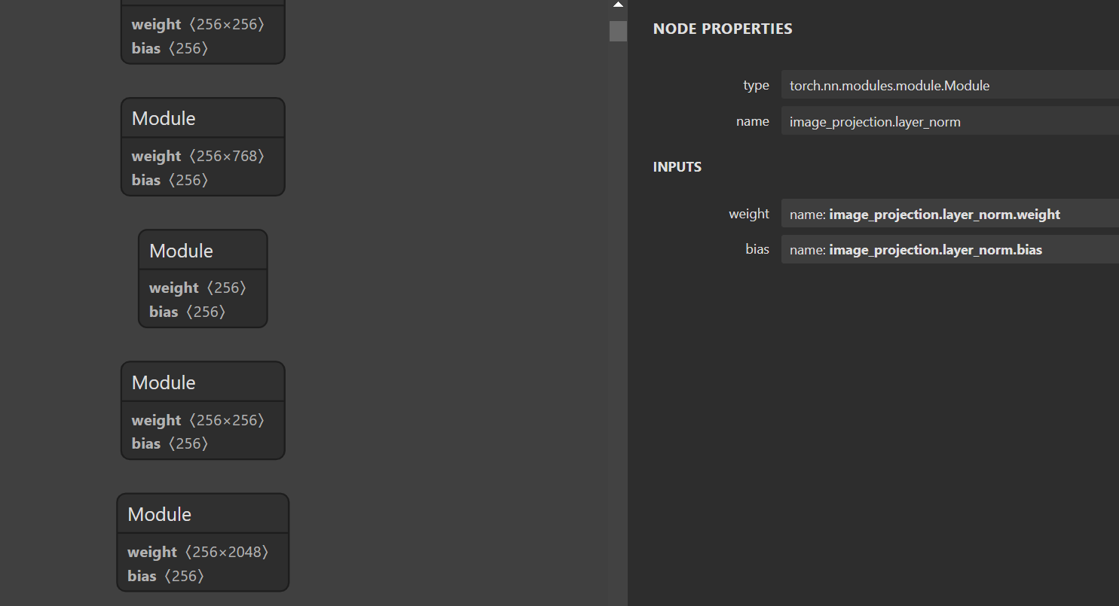
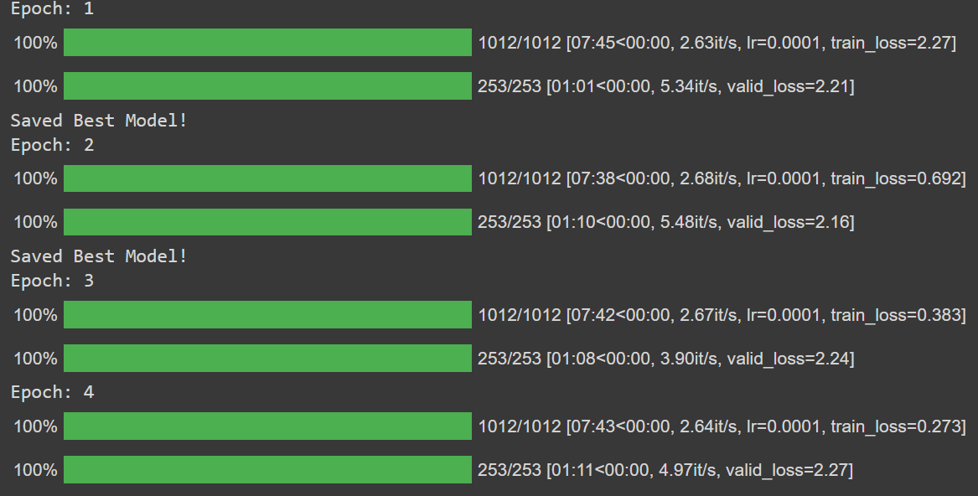
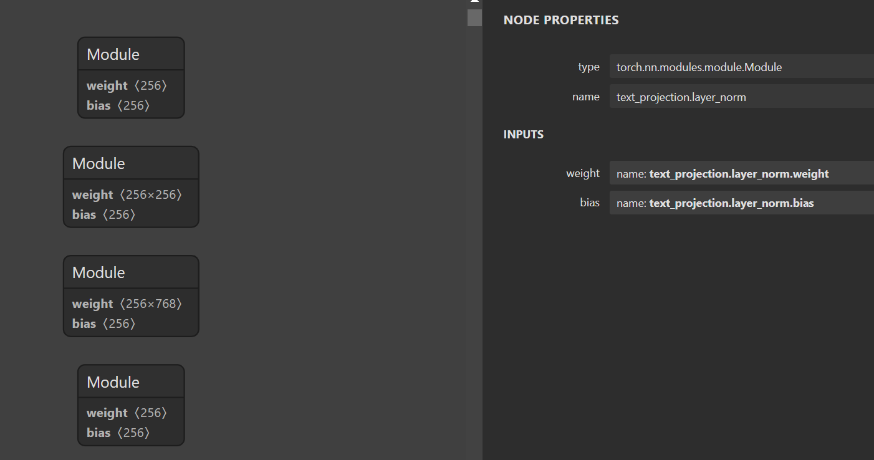
CLIP simple implementation
Trained with flikr8k dataset.

Slide 6
Distilling Large Vision-Language Model with Out-of-Distribution Generalizability

Slide 7
Approach
The distillation of visual representations in large teacher vision-language models into lightweight student models
Enhance student’s OOD generalization:
(1) by better imitating teacher’s visual representation space, and carefully promoting better coherence in vision language alignment with the teacher.
(2) by enriching the teacher’s language representations with informative and fine-grained semantic attributes to effectively distinguish between different labels.

